Slide 1
Welcome to UMB!
UMB IT Resources
for
New Employees

Slide 2
Agenda
What is the UMID
Preferred Name
DUO Multi-Factor Authentication (MFA)
UMB Alerts
myUMB Portal
Electronic Timesheets
Training Opportunities
Eduroam Wireless Access
Microsoft Applications
Email Login
Conferencing Software
CITS
IT Security
Help Desk
Training
CITS Services

Slide 3
What is the UMID?
Your UMID is a unique username that you will use to create your account on the UMB Account Management Site.
The UMID is a crucial part of the single sign-on (SSO) system that will reduce the number of passwords and logins each user must remember and maintain.
First, you will need to receive your workstation/email ID and temporary password from your supervisor.
Create your UMID Account & password through https://directory.umaryland.edu/.
Workstation/ Email ID = provided email address NOT including @umaryland.edu
This will synchronize the passwords for these 2 accounts so that you will login to your email, computer, and all UMID- protected systems with the same password
Account Management site:
https://directory.umaryland.edu/ OR
myUMB Portal – “Manage your UMID” under Self-Service

Slide 4
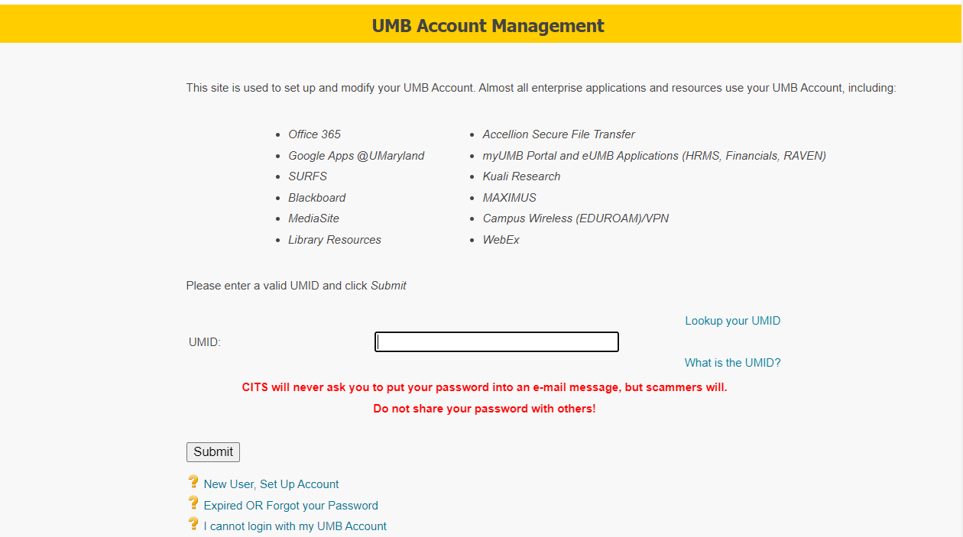

Slide 5
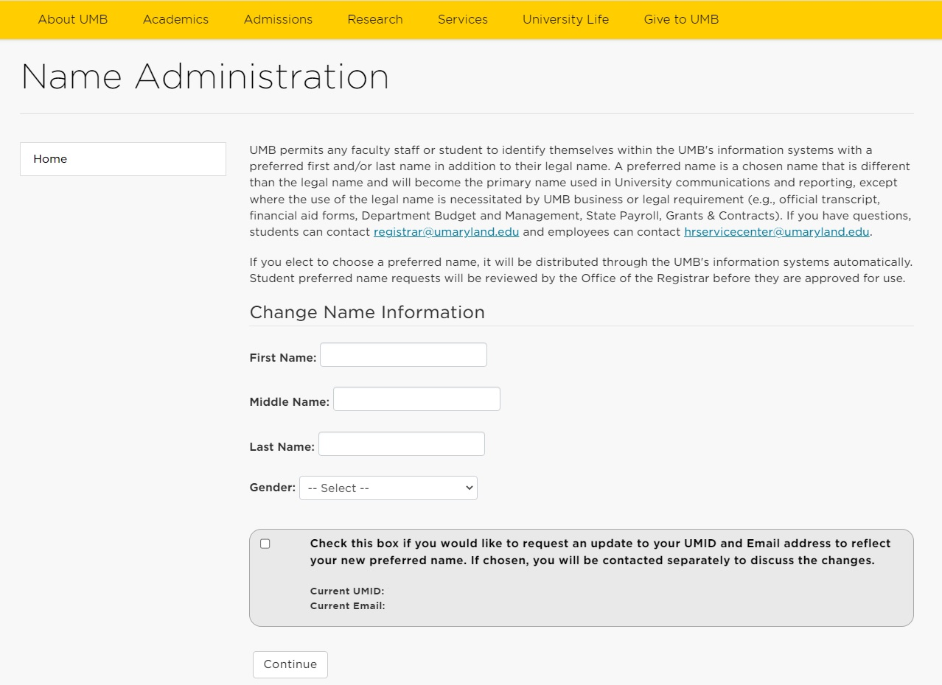
Preferred Name
Preferred Name allows any faculty, staff or student to identify themselves within UMB’s information systems with a preferred first and/or last name in addition to their legal name.
Update through:
https://cf.umaryland.edu/preferred_name/main.cfm OR
myUMB Portal – “Preferred Name” under Self-Service

Slide 6
DUO Multi-Factor Authentication
DUO is the application used by UMB for Multi-Factor Authentication, which provides a 2nd level of identity checking.
Utilizing a Multi-factor Authentication like DUO allows us to keep our files and data secure
When you access various web applications with your UMB email and password, you will be required to authenticate who you are using DUO on a different device
You can download the DUO Mobile app on your smartphone or tablet
Enroll in Duo at: https://www.umaryland.edu/cits/services/duo/enrollment
General Information: https://www.umaryland.edu/duo
Notes:
Another important tool that you will absolutely see on a regular basis is multi-factor authentication. IT Security is a very important topic at UMB, and MFA, as it’s often referred to, is what allows us to have an extra level of security when signing into various applications.
Specifially, DUO is the application that we use and can be downloaded onto your smartphone or tablet to provide the 2nd level of identity checking.
Instructions and additional information on the Duo app can be found on the websites listed here.

Slide 7
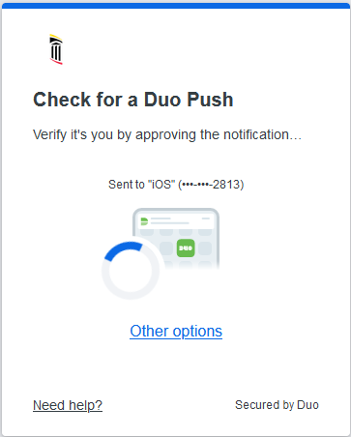
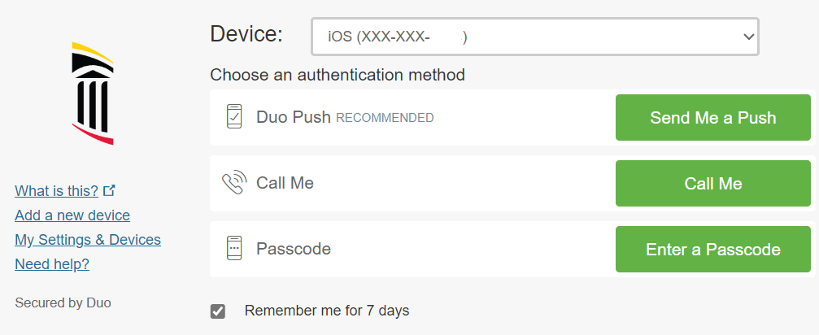
DUO Multi-factor Authentication
New Duo Prompt Current DUO prompt
From this page you can:
Choose your Authentication Method if you have registered a device (Download the DUO Mobile App and use the PUSH Function!)
Add a new device or edit your settings for DUO
You can download the DUO Mobile app on your smartphone or tablet
Notes:
When you sign into any application that requires MFA, this window will appear.
You have 3 options – Push, call or passcode.
We recommend using the Push method, which will send a notice to your smartphone or tablet and you simply need to select “Approve” and it will sign you in.
We also recommend selecting “Remember me for 7 days”. This will by pass needing to send a push every time you sign in.
To the left are links that allow you to add a new device and also review and update your personal settings.

Slide 8
DUO Best Practices
Download the DUO Mobile App and utilize the Push Function
Register a 2nd Device
Use a Face Recognition Lock or Pass Code Lock on your personal Device
Check the "Remember Me for 7 Days" Box (do not use on public/shared devices)
Notes:
Review slide.

Slide 9
UMB Alerts
UMB Alerts is the system used by the Emergency Management Team at the University of Maryland, Baltimore to notify the campus community about emergencies and weather related closings.
You are automatically signed up for UMB Alerts via email, but can register to get SMS texts as well!
You will be prompted to set up SMS Text Notifications for UMB Alerts as you are setting up your UMID on the Account Management Site as well!
To learn more visit: https://www.umaryland.edu/emergency/alerts
Notes:
Review slide.

Slide 10
myUMB Portal
The myUMB Portal provides access to many applications, tools, and news pertinent to the UMB community
You can access the portal from the UMB Home Page: https://www.umaryland.edu
It is located on the top left of the banner
You can also access the portal directly at: https://myumb.umaryland.edu/

Slide 11
Notes:
This is a screenshot of the portal. Keep in mind – what YOU will see will be based on YOUR security role in our system, which includes if your exempt or non-exempt, what department or school you work for, and even your specific job. When you first access the portal, it will look different than what you see here.
But what is the same across the board:
In the upper left-hand corner are UMB Icons. Certain icons will default, including access to your timesheet.
Then, the rest of the screen is comprised of Widgets. Each box we see is a Widget. Certain Widgets will default into view, and what is great about this portal – it’s customizable! As you start to settle in here at UMB, you can remove widgets you know you won’t need, add widgets you would like easy access to, and move the order of the widgets! I’ll get to that shortly.
Some other items to point out:
Everyone will have the Self-Service widget – you can access your timesheet from here too, if you want to make changes to your UMID account – you can access it from here, and preferred name too!
The HR widget will also appear for everyone, and it provides access to your paycheck information and W2’s. What we don’t see in the screen shot – you can also access your leave inquiry and our university Learning Management System (LMS).
Another widget that may be helpful is the Training & Tutorials widget. This will NOT appear by default! If you want to access it, you will need to add it. What it provides is easy access to various training tools. If you’ll be working with our financial system – Quantum – the tutorials can be found here. Same with the eUMB systems – timesheet training can be found here, along with other Payroll related training. And the UMB Systems Training will access our training database that allows you to access and enroll in live training – both virtual and in person. I’ll come back to that later!
Then there is the Settings icon. The Gear icon will take you to your settings AND, more specifically, to Help.

Slide 13
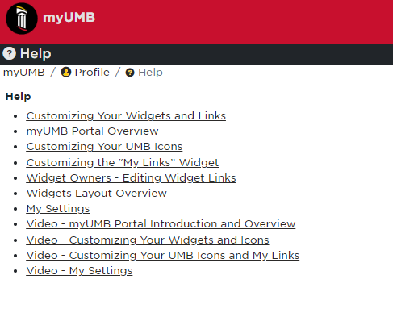
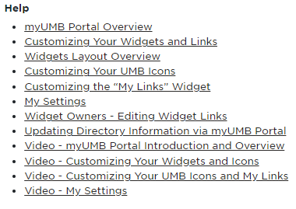
Customizing Your Portal!
Notes:
This is the Help widget which provides instructions on how to customize the portal.

Slide 14
Electronic Timesheets
Most employees are required to submit Electronic Timesheets (ETS)
Electronic Timesheets (ETS) – Document hours or days worked and leave taken (if eligible)
Exempt faculty and staff record duty days (“D” rather than work hours)
Non-Exempt employees record in and out hours worked
For training, visit:
eUMB Systems Tutorial Browser in the myUMB Portal
Direct tutorial Link: http://cf.umaryland.edu/ondemandtraining/enterprise/PlayerPackage/
For more information, visit: https://www.umaryland.edu/policies-and-procedures/library/financial-affairs/procedures/
Notes:
All employees will fill out a timesheet every other week. Exempt employees will just record Duty days, non-exempt will need to enter their hours worked. To learn more about your timesheet and how to complete it, please view our training tutorials. They can be directly accessed at the link listed here, or through the portal and the Training & Tutorials widget that we saw a few moments ago.

Slide 15
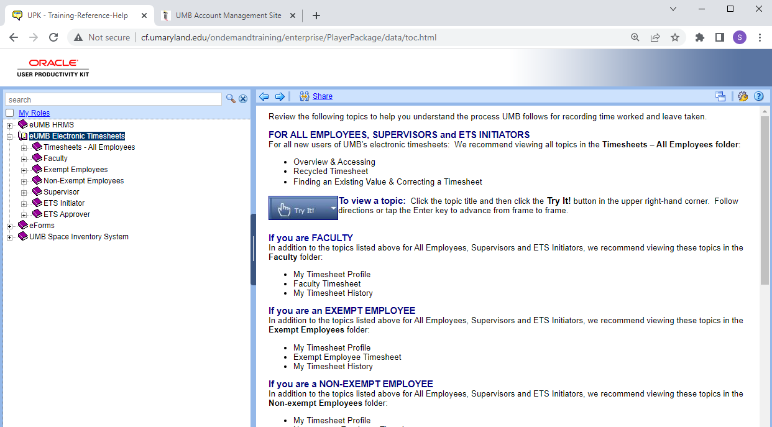

Slide 16
Training Opportunities
Self Paced / E-learnings - visit our Learning Management System (LMS) at https://www.umaryland.edu/hrs/ OR through
myUMB Portal – “Employee Learning (LMS)” under HR
Annual required trainings can be found here, along with an extensive catalog of school/dept specific trainings.
Instructor Led Trainings (In person and virtual) - visit our training enrollment site at https://cf.umaryland.edu/cits_training/home.cfm OR through
myUMB Portal – “UMB Systems Training” under Training & Tutorials
To enroll in a class, click “Add Course”, then select “Course Type”. Courses will be listed, including a course description and a link to register.
Notes:
There are 2 primary sources to access UMB training:
Our LMS, which provided self-paced and elearning options. Various departments and schools on campus use the LMS to provide training to employees, and any required training are offered through the LMS. Additionally, there is a Skillsoft catalog that offers a large number of tutorials on variety of topics. It can be accessed from the HR website at this link, or through the myUMB portal.
Then we have our training database where instructor led courses are offered – whether they be in person of virtual.

Slide 17
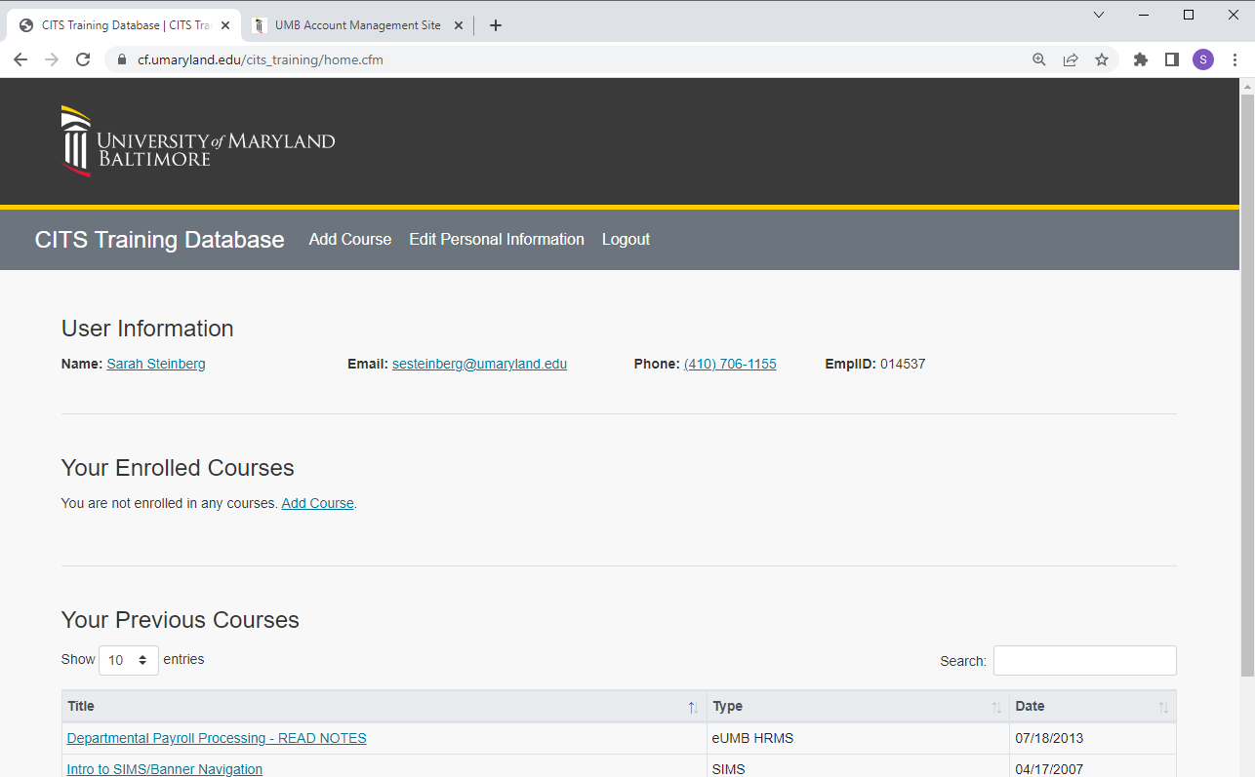

Slide 18
Eduroam Wireless Access
Eduroam (or Education Roaming) was developed for International Research and the Education Community and has allowed the University to enhance its wireless network
Eduroam allows students, faculty, and staff from participating institutions to obtain internet connectivity across campus and when visiting other participating institutions by utilizing their UMaryland Email login on their laptop or smartphone.
Eduroam Wireless is the preferred connection on campus as it is part of the University’s Network and will grant you faster access to multiple websites and applications
Once connected you are registered and connected to Eduroam, you can actually connect to Eduroam at any UM Institution that offers it as well!
For more information visit: https://www.umaryland.edu/cits/services/eduroam/

Slide 19
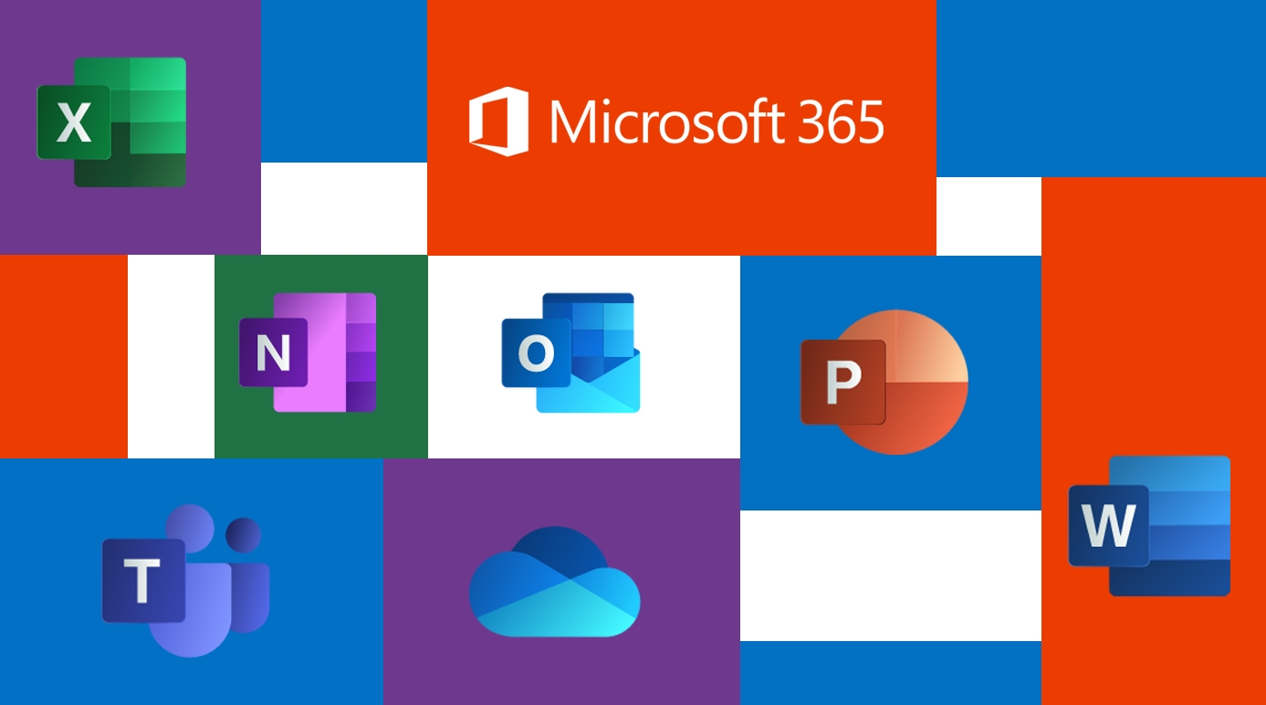
Microsoft 365
Microsoft 365 allows access to all your files and information anywhere, anytime!
Some Microsoft Applications that you may use on a day to day basis include: Outlook / OneDrive / Sharepoint / Office Suite / Teams
Client/Desktop versions of Outlook and the Office Suite are installed on your UMB issued computer
You can also access all of these applications and more as long as you have internet connection and a personal device at: https://portal.office.com

Slide 20
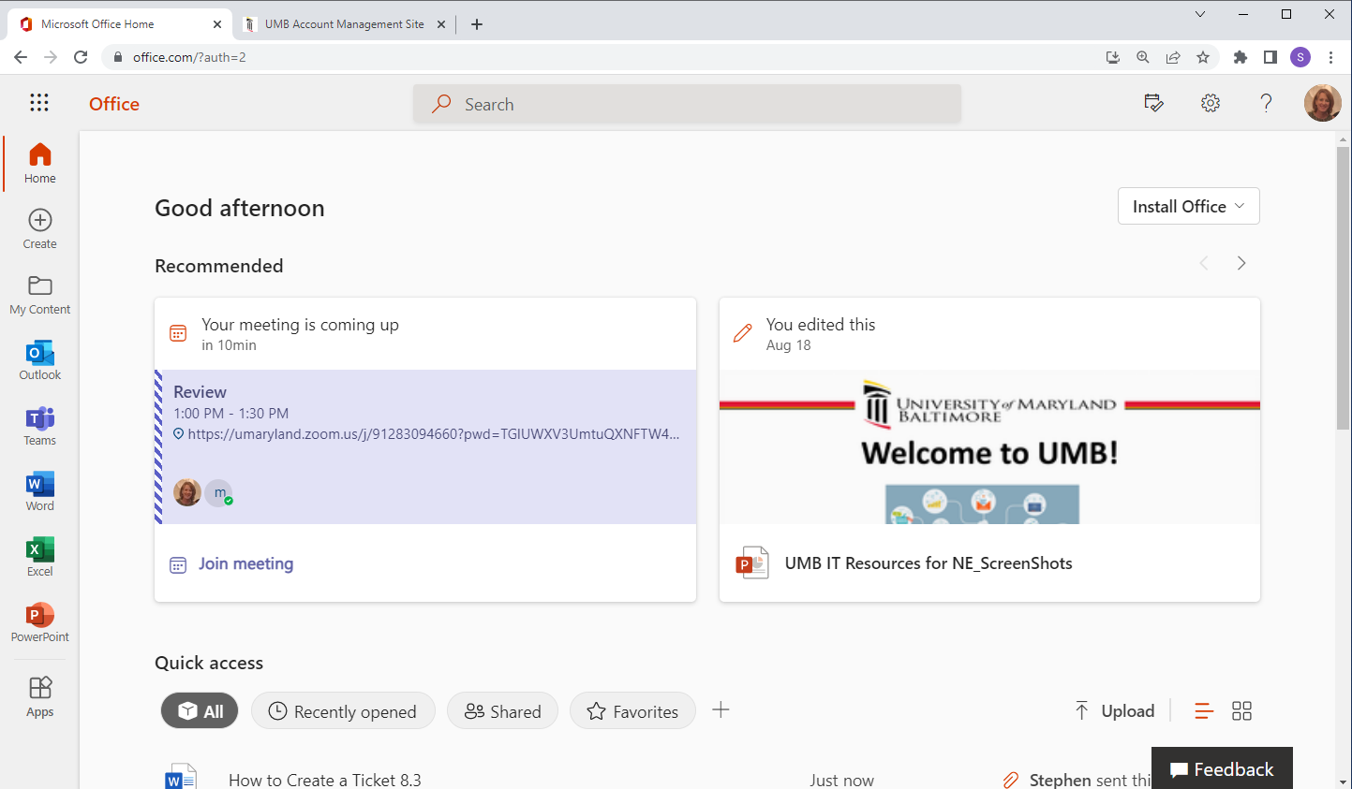

Slide 21
Outlook Email
Outlook email is UMB’s primary method to share information and communicate with the UMB community
Access your UMB Outlook Email via the client app on your UMB computer
You can also access your UMB Outlook Email remotely at: http://portal.office.com
Enter your UMB email address and password
This email account will be used to communicate all pertinent UMB business and information
To learn more about Office 365, visit http://umaryland.edu/office365
Notes:
Review slide.

Slide 22
Conferencing Software
Zoom
Support Site
umaryland.edu/zoom
Web Interface
umaryland.zoom.us
Webex
Support Site
umaryland.edu/webex
Web Interface
umaryland.Webex.com
Teams
Support Site
umaryland.edu/office365
Web Interface
portal.office.com
To learn more about these conferencing tools visit: https://www.umaryland.edu/cits/services/a-z-service-listing/

Slide 23
CITS Website
CITS provides additional resources and information on important IT related applications, services and trainings.
https://www.umaryland.edu/cits/

Slide 24
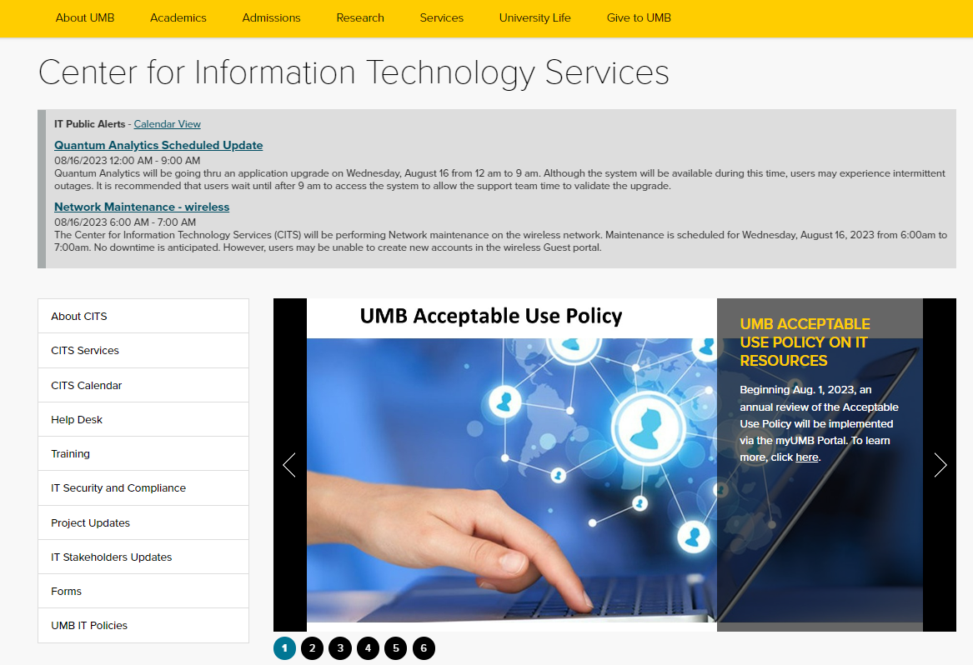

Slide 25
IT Security Best Practices
In this day and age of technology, IT Security is more important than ever. Please review and follow the following best practices to help ensure the safety of your data.
1. Use two-factor or multi-factor authentication (MFA) for all personal accounts or services that support this technology.
2. Only accept DUO requests when you are actively trying to login to a system or application.
3. Ensure that your personal computer has the latest version of the operating system and keep your software up to date by turning on automatic updates.
4. Ensure that you are using antivirus protection, with regular updates.
5. Beware of suspicious emails and phone calls because they could be phishing scams and/or contain malware.
To view a full list of monthly security articles that have appeared in the Elm, go to https://www.umaryland.edu/cits/it-security-and-compliance/security-awareness/.
Notes:
IT Security is a part of the CITS family and as security is such an important topic - review slide.

Slide 26
IT Help Desk
The IT Help Desk provides support to faculty, students, staff, affiliates and all community system members for all campus-wide applications.
To reach the central IT Help Desk:
Email: help@umaryland.edu
Call: 410-706-HELP (4357)
To reach School specific Help Desks:
School of Dentistry – 410-706-2084
School of Law – 410-706-5771
School of Medicine – 410-706-3998
School of Nursing – 410-706-4357
School of Pharmacy – 410-706-4488
School of Social Work – 410-706-3619
Support Site: https://umaryland.edu/helpdesk
Notes:
The central IT help desk, that is available to everyone on campus for help with campus wide applications, can be contacted via email at help@umaryland.edu or by phone at the number listed here. Additionally, each school has their own help desk, and depending on what system you need help with, you may need to go to your school specific help desk.
Additionally, there is a website for the Help Desk and it offers a lot of important information.

Slide 27
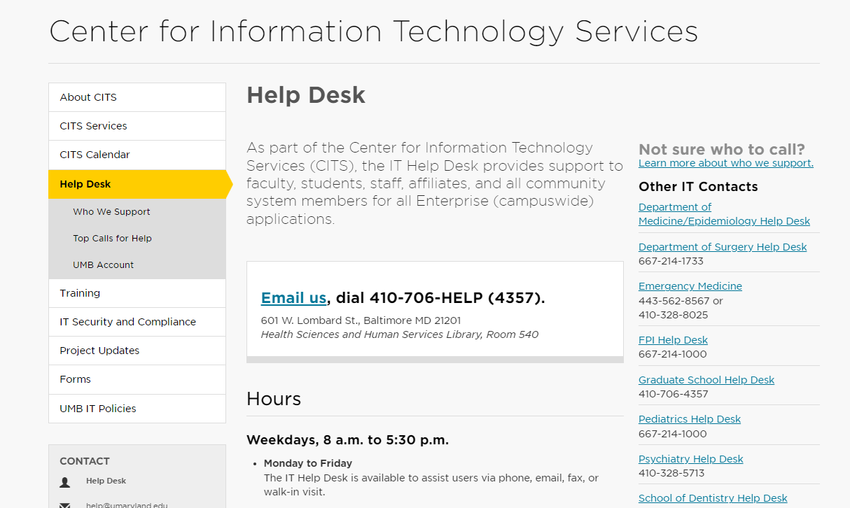

Slide 28
IT Help Desk Tips
Web Browser – for any web-based application/system that is causing an issue:
Try another browser
Clear the browser cache/history
Reboot your computers
Try again!
When E-mailing the Help Desk, include:
A useful subject line
Any error message
The URL or system name
A screen shot of the problem
Your name
Affiliation
Review the Top Ten Calls to the Help Desk for a possible quick solution to your issue!
Notes:
Some basic tips when experiencing problems or sending an email to the Help Desk.

Slide 29
IT Software
The Software Licensing Office was created to assure the availability of site-licensed or educationally priced software to members of the University of Maryland community
To learn more about prices and software and licenses available, visit:
https://umaryland.edu/cits/software
Email: help@umaryland.edu
Notes:
Review slide.

Slide 30
IT Training
The IT Training & Communications department designs and delivers training on campuswide business applications, including the Microsoft 365 suite of products.
Office Support Site: www.umaryland.edu/office365/
Training Resources Page – Important and timely training topics
Applying sensitivity labels
Sending secure emails – [secure]
Notes:
We’ve already mentioned a number of training resources available to you, we want to point out the CITS IT Training department. We offer training on campuswide applications, which primarily includes the Microsoft 365 suite of products – including OneDrive, SharePoint, Teams and more.
The office support site can be accessed from umaryland.edu/office365
Additionally, found under Training is the Training Resources page, which offers information on timely and topical issues, including applying sensitivity labels to office files and how to send secure emails.

Slide 31
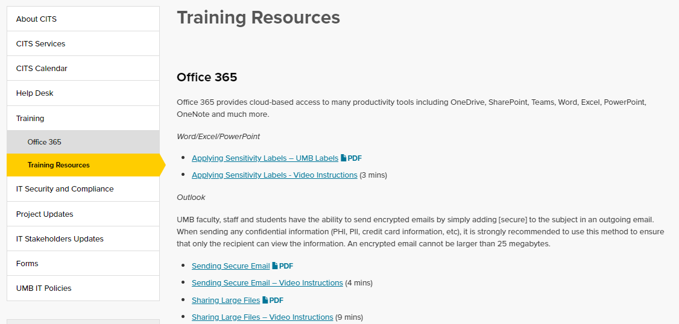

Slide 32
CITS Services
The CITS Services page allows users to search for information on various applications and services available at UMB.
https://www.umaryland.edu/cits/services/
Notes:
The CITS Services page allows users to search for support pages related to various applications and services available at UMB.

Slide 33
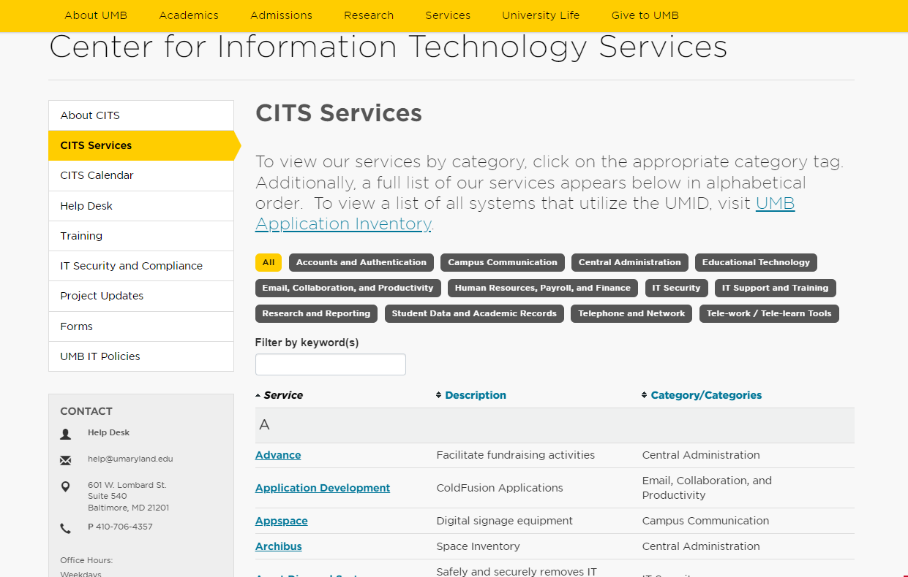

Slide 34
Thank you and
good luck!

